Slide 1
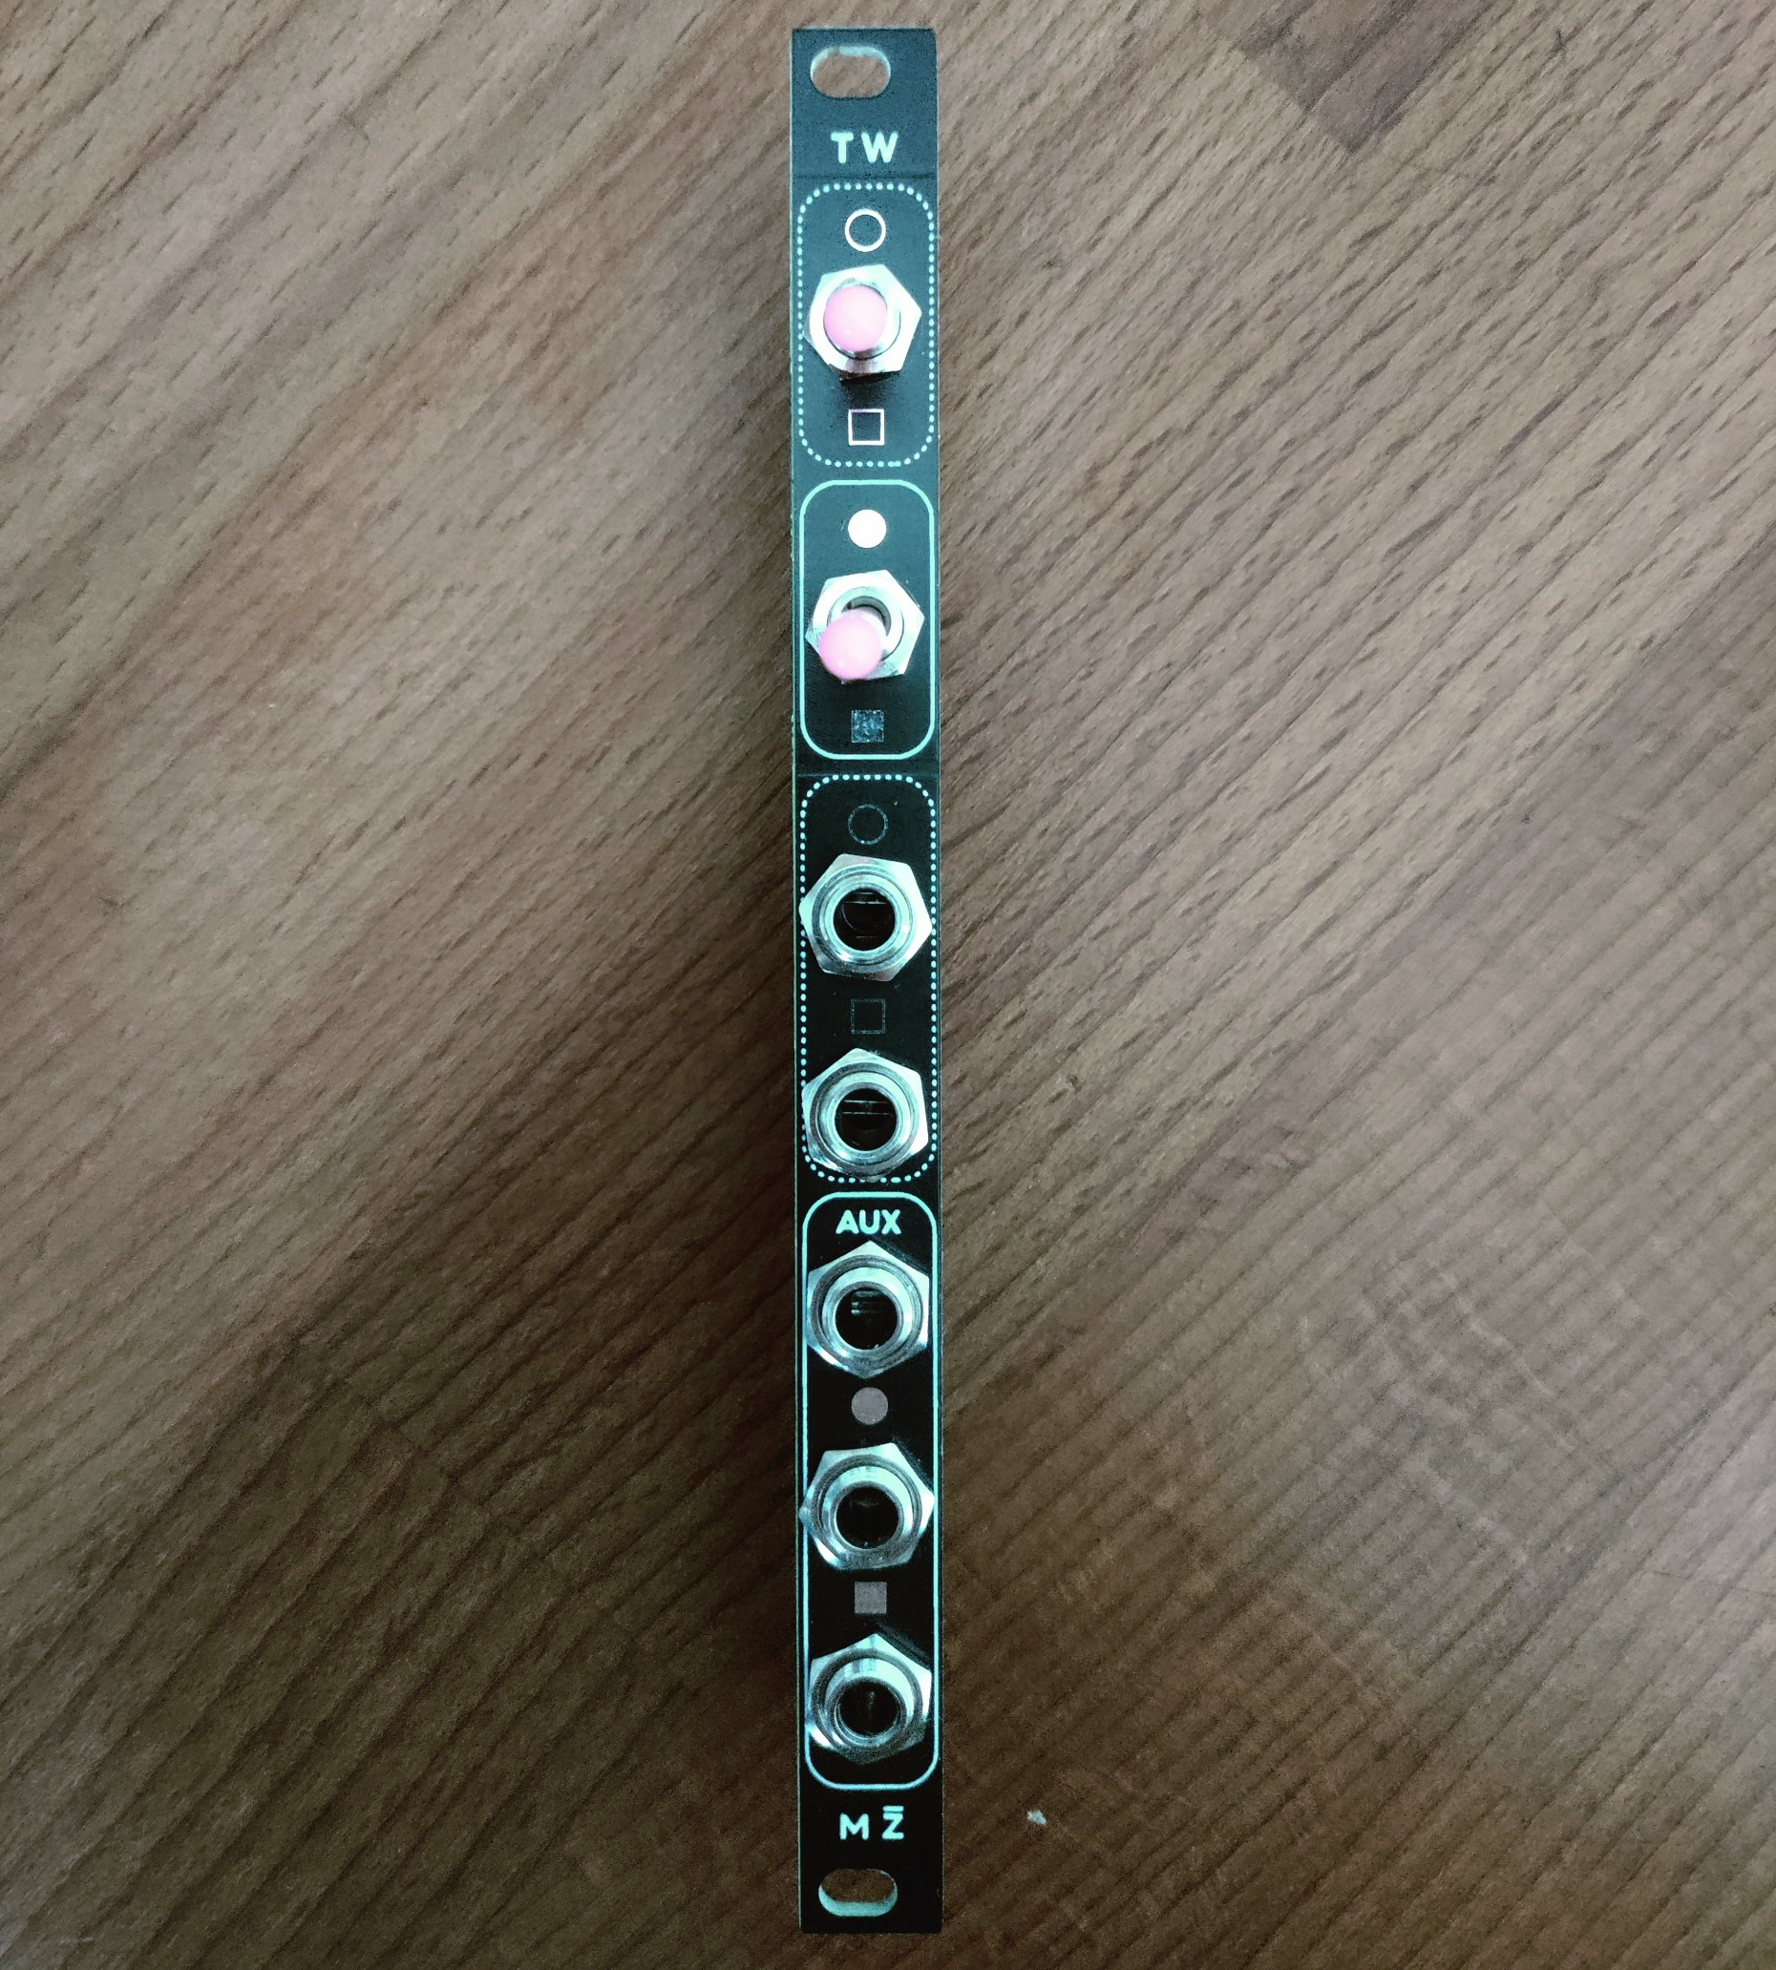
MŽOURACK - Trigger Warning is a 2HP passive trigger/gate processing utility which is designed with live performance in mind. It allows you to quickly and intuitively perform operations like switching, combining and muting trigger/gate signals.
Note that the circuit is designed for standard eurorack positive trigger and gate signals. Using other types of signals will result in odd behaviour, for example, only the positive parts of LFOs will appear on the output. A slight voltage drop will be present even with gates and triggers.
A) 3-position switch for switching between inputs:
TOP position – Only input A
MID position – A + B (Logical OR)
BOT position – Only input B
B) 2-position switch for routing the signal to the outputs:
TOP position – Output A
BOT position – Output B
C) Input A
D) Input B
E) Output A
F) Output B
G) AUX output, always active and unaffected by the 2-position output switch
A
B
C
D
G
E
F

Slide 2
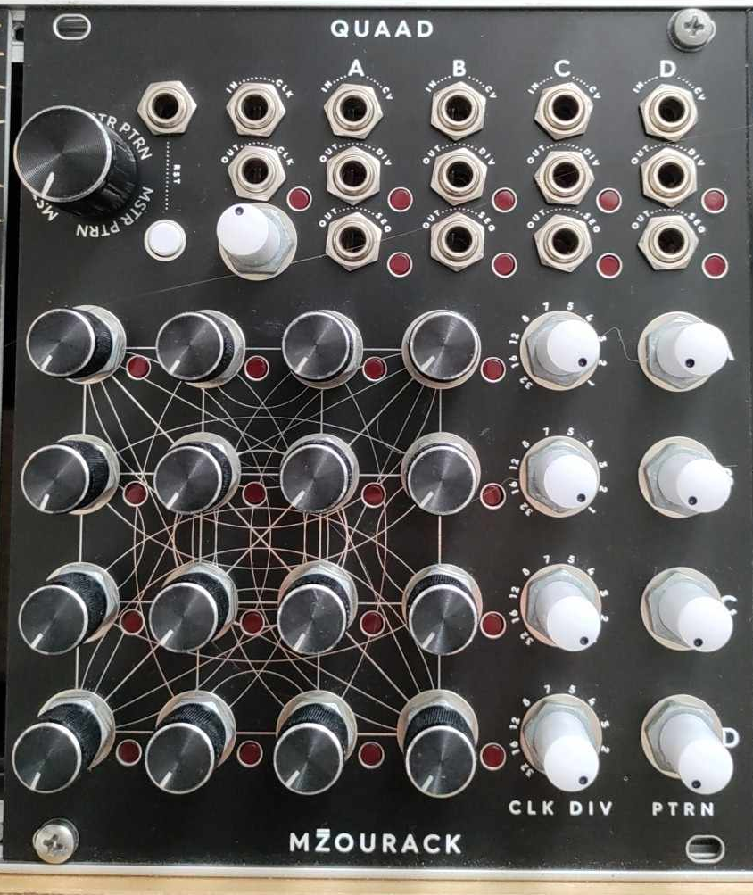
Start here!
Minimum
The tempo is up to you
Maximum
Minimum
MŽOURACK – QUAAD is a 22HP module which consists of four independent 4-step sequencers. Each of them features a CV output (0-5V), a clock divider and a pattern setting. Patterns can be changed per-sequence via a dedicated knob or via CV, aswell as globally using the MSTR PTRN knob.
The module is designed with live-performance setting in mind, allowing for rapid changes to the behaviours of the outputs.
On the right is the recommended starting point for using this module for the first time.
Minimum
Start here!

Slide 3
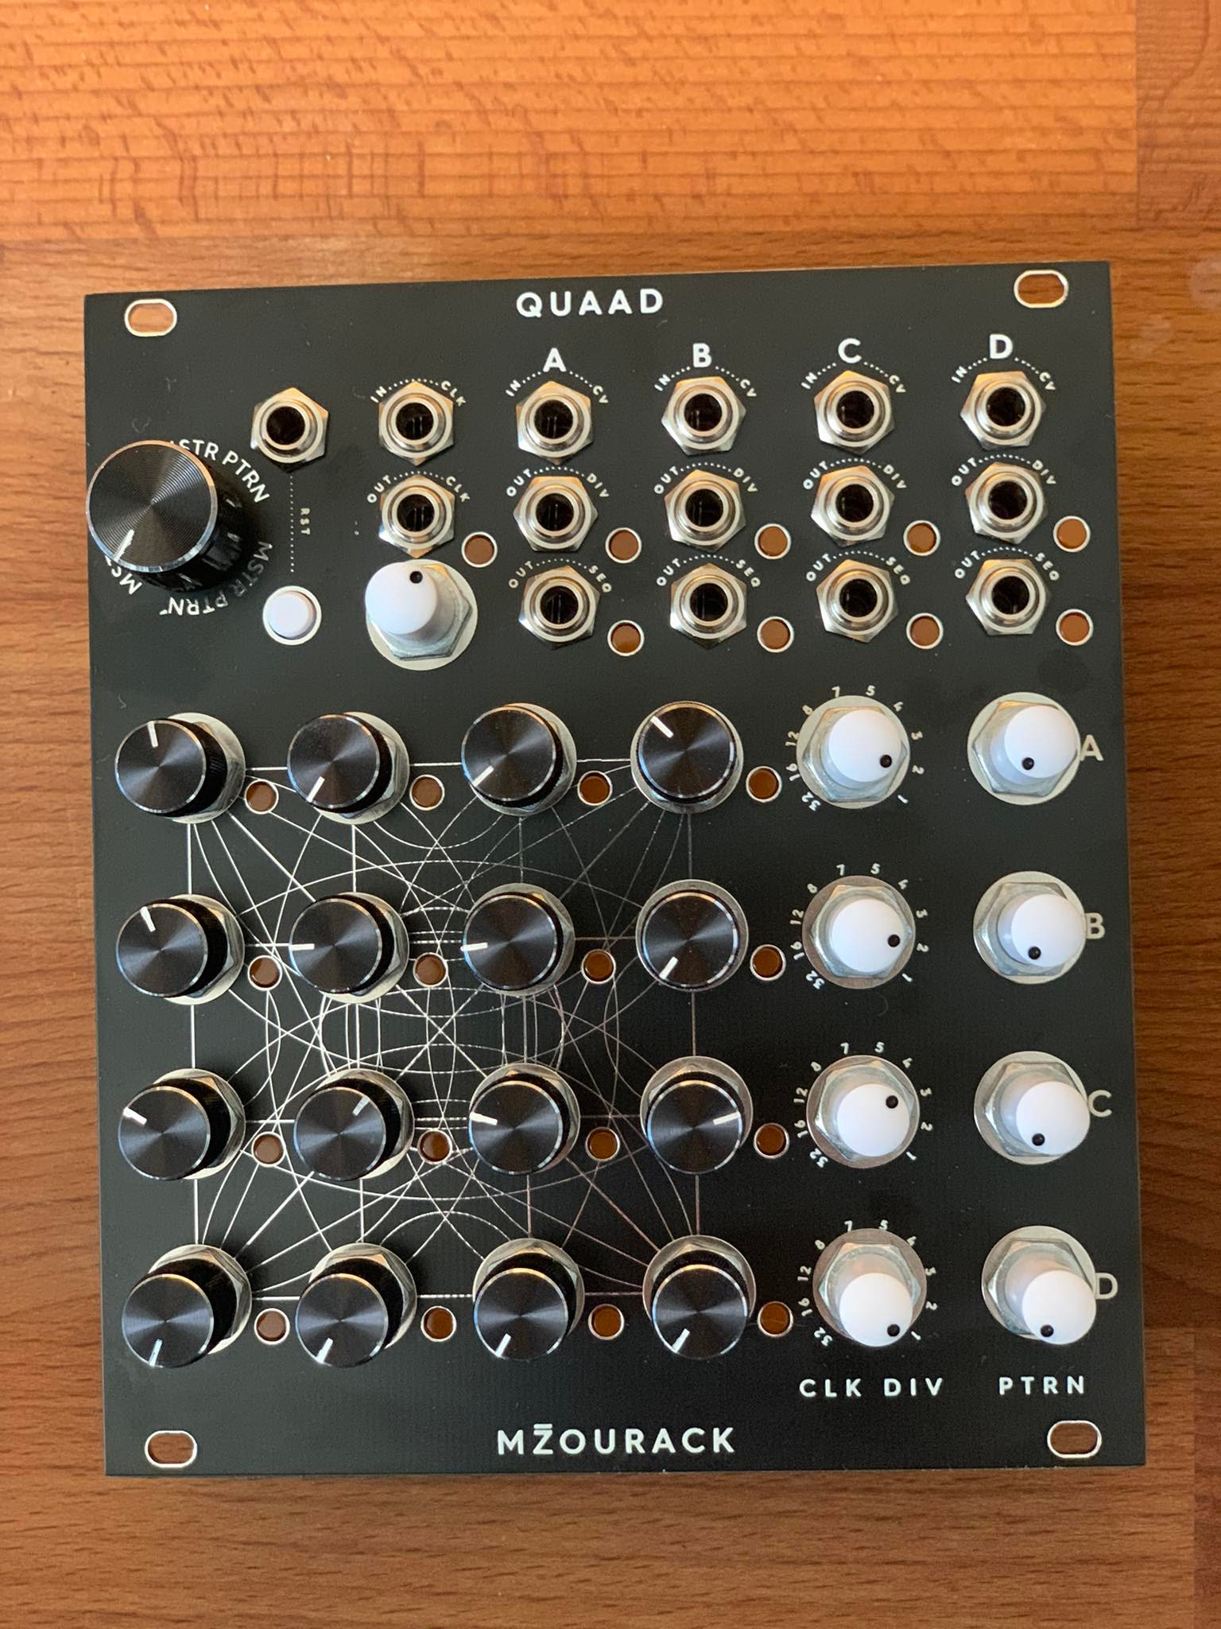
A) 4 knobs per channel for setting the output-voltage of the sequence per-step. Output voltage is unquantized, 0-5V.
B) Clock dividers per-channel set how many clock signal pulses are needed to progress the sequence. Available divisions are 1-2-3-4-5-7-8-12-16-32.
C) Here the pattern of each channel can be selected manually.
D) CV inputs for individually changing the pattern of each channel
E) Global pattern change – adds an identical CV offset to each input in D)
C)+D)+E) There are 6 patterns available – these change the order of steps through which the sequence progresses. The patterns are listed below in the order in which they accessed with C)+D)+E):
1-2-3-4 1-2-4-3 2-4-1-3 3-4-2-1 4-2-3-1 4-3-2-1
All are unique permutations, so that in a repeating sequence, the same pattern cannot be extracted from any pair of the available patterns.
The ranges of E) and C) are designed so that one can use either of these controls to scroll through all the available patterns. All patterns are also available with 5V wide CV range used in input D). Negative CV inputs are also useable, and scanning for patterns outside of the first 6 listed above will result in looping to the other end of the selection.
Self-patching to modulate the pattern of one sequence with another is advised!
F) 0-5V CV output per channel.
G) Clock divider output per channel. Gate length is equal to that of the incoming clock signal.
H) Clock input, output, and internal clock generator tempo setting. This knob does nothing when external clock is used. Experimenting with non-steady clock signals is advised!
I) Reset input + and manual reset. Sets all channels to the first pattern step on the next clock tick.
I
H
E
D
G
F
A
B
C

Slide 4
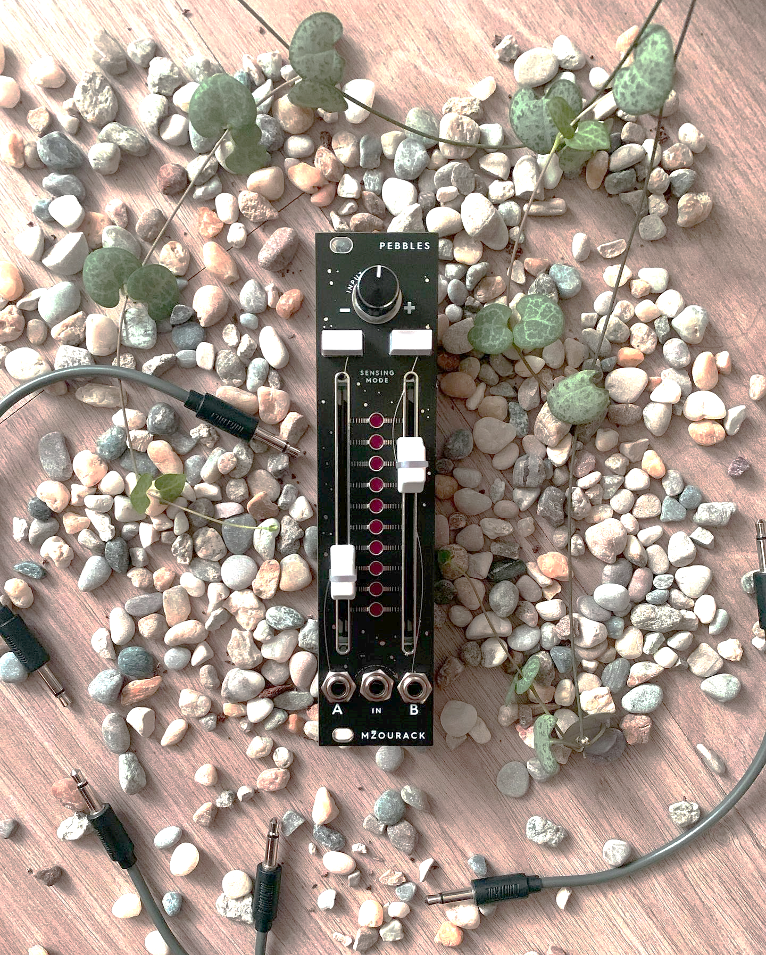
MŽOURACK – Pebbles is a 6HP dual channel Trigger-From-CV generator. The way the module operates is highly visual, so I advise you to skip this guide altogether and watch the video instead!
A) The CV input of the module. Feed any type of CV here to extract rhythms from it.
B) Attenuverter to scale and invert the incoming CV signal.
C) The LED strip vizualizes the scaled CV signal. The middle of this strip corresponds to 0 volts. Use the faders to set CV levels at which triggers are generated.
D) These buttons change the so called sensing mode.
OFF state - triggers are only generated when the CV signal passes the fader from below (↑)
ON state – triggers are generated when the CV signal passes through the fader level in either direction (↑↓)
E) Outputs of the two channels. Note that with nothing plugged into output A, both channels will be outputted via output B
B
D
C
E
A

